Slide 1
Smart Contracts

Slide 2
What is a Smart Contract?
A smart contract is a self-executing program stored on a blockchain that runs when predefined conditions are met.
Lives on a blockchain (e.g., Ethereum)
Executes automatically, no need for intermediaries
Immutable once deployed

Slide 3
Analogy — Vending Machine
A Vending Machine is Like a Smart Contract
You insert money
Select item
Machine checks rules (money/item match)
Dispenses snack
Smart Contract = “If this, then that” machine

Slide 4
Why Smart Contracts?
KEY BENEFITS:
TRUSTLESS TRANSACTIONS
TRANSPARENCY
AUTOMATION
SECURITY
No need for:
Lawyers
Escrow services
Manual verification

Slide 5
How Smart Contracts Work
Written in programming languages (Solidity, Vyper)
Deployed to blockchain
Users interact via wallets (e.g., MetaMask)
Nodes validate and store outcomes

Slide 6
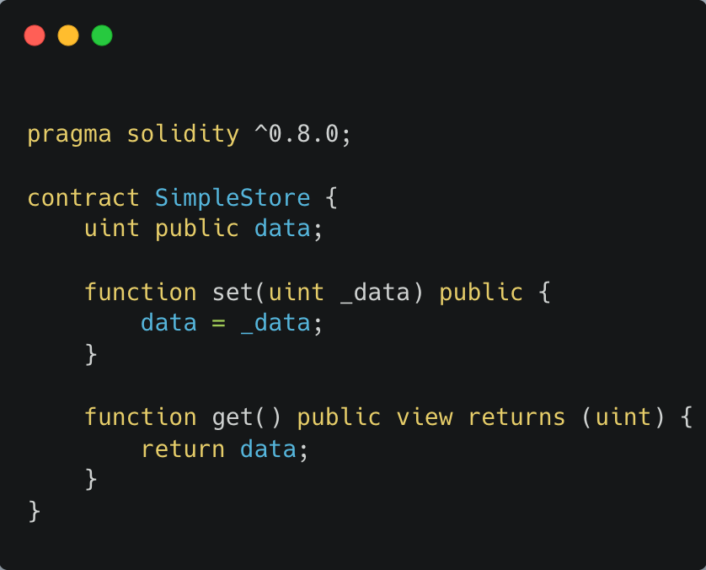
Basic Solidity Smart Contract
This contract stores and retrieves a number.

Slide 7
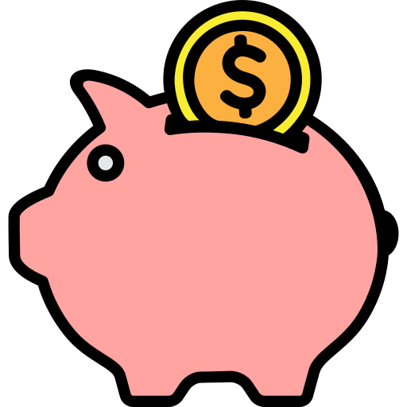
Digital Piggy Bank
Imagine:
Only you can put coins in
Everyone can see your balance
Rules can't be changed
Blockchain smart contract = digital piggy bank

Slide 8
Oracles
A blockchain oracle is a service that feeds external data into a blockchain, so smart contracts can use it.

Slide 9
What Oracles Can Provide
🔮 Price feeds (e.g., ETH/USD)
⛅ Weather data
📈 Stock market prices
🏟️ Sports scores
📊 Election results
💳 Bank or payment info

Slide 10
How Oracles Work with Smart Contracts & Blockchain
Problem:
Smart contracts can’t talk to the outside world (like web APIs, weather data, or stock prices) on their own.

Slide 11
Oracle’s Role
An oracle acts as a middleman that:
Fetches data from outside the blockchain
Delivers it securely to the smart contract

Slide 12
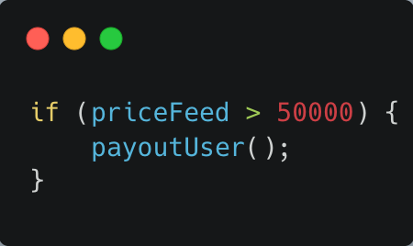
Example Use Case
A smart contract pays a user if Bitcoin goes above $50,000
But where does priceFeed come from? The contract can’t pull price data on its own.

Slide 13
Oracle (like Chainlink) Watches for Data Requests
The smart contract sends a request:
"I need the current BTC/USD price."
Oracle Fetches Real-World Data
The oracle contacts external APIs (e.g., Binance, CoinGecko, etc.).
It aggregates results from multiple sources.
Oracle Delivers the Data On-Chain
It sends the answer back to the smart contract via a transaction.
This data is now stored in a new block on the blockchain.
Smart Contract Executes Based on the Data
The contract receives the updated price (e.g., $50,100)
It checks the condition, and if met, it executes the payout.

